Slide 1

Title
Mohamed Abbas
11/4/2026

Slide 2



OUTLINE
Executive Summary
Introduction
Methodology
Results
  Visualization – Charts
  Dashboard
Discussion
  Findings & Implications
Conclusion
Appendix

Slide 3

EXECUTIVE SUMMARY
Point 1: JavaScript Dominates Current & Desired Tech Stack
Sub Point 1: JavaScript is the #1 language used (14,943 respondents) and #1 language developers want to learn (11,541)
Sub Point 2: SQL and HTML/CSS round out top 3 for both current usage and learning desire
Sub Point 3: TypeScript ranks 4th in both categories, showing strong adoption momentum
Point 2: PostgreSQL Leads Database Preferences, Redis Rising
Sub Point 1: PostgreSQL is the most used database (11,514) and most desired (12,193)
Sub Point 2: Redis jumps from 6th in usage to 2nd in desire (6,384), indicating high learning interest
Sub Point 3: MongoDB maintains top 5 in both, showing sustained NoSQL relevance
Point 3: Cloud Platform Landscape — AWS Dominates, Multi-Cloud Growing
Sub Point 1: AWS leads both current usage (10,871) and future interest (10,516)
Sub Point 2: Azure and Google Cloud hold 2nd/3rd in both categories, confirming big-three cloud dominance
Sub Point 3: Cloudflare and Digital Ocean show strong developer mindshare for edge/hosting
Point 4: Compensation Grows Steadily with Experience & Age
Sub Point 1: Median compensation rises from ~$12K (under 18) to ~$127K (55-64), peaking at $101K (45-54)
Sub Point 2: 25-34 age group (largest cohort: 7,788 respondents) earns median $60K
Sub Point 3: Professional coding experience (YearsCodePro) shows clear correlation — 10+ years correlates with $75K+ median
Point 5: Developer Demographics — Experienced, Educated, Full-Time
Sub Point 1: 74% are full-time professional developers; 66% hold Bachelor's or higher
Sub Point 2: Core workforce is 25-44 years old (66% of respondents)
Sub Point 3: Job satisfaction (JobSatPoints_6) peaks at 20/100 for ages 18-64, dips for youngest/oldest groups

Slide 4

INTRODUCTION
- Purpose of the Report:
Point 1: Provide a comprehensive overview of the 2024 developer technology landscape based on 65,437 survey respondents across 185 countries
Point 2: Identify current technology usage patterns and future learning intentions to guide skill development and hiring decisions
Point 3: Analyze compensation trends and job satisfaction drivers across demographics to inform career planning and retention strategies
Point 4: Deliver actionable insights for technology investment and workforce planning
Sub Point 1: Data-driven justification for training budgets (e.g., Redis, TypeScript, cloud platforms)
Sub Point 2: Benchmark compensation by age/experience to align offers with market rates
- Target Audience:
Point 1: Engineering managers and tech leads planning team skill development
Point 2: HR and talent acquisition teams benchmarking compensation and hiring criteria
Point 3: Individual developers and career switchers prioritizing learning investments
Point 4: Technical executives evaluating technology stack decisions
Sub Point 1: CTOs/VP Engineering assessing cloud/platform standardization
Sub Point 2: Training providers designing curriculum aligned with market demand
- Value of the Analysis:
Point 1: Reveals gap between current skills (JavaScript, SQL, PostgreSQL) and emerging demand (Redis, TypeScript, cloud-native)
Point 2: Quantifies compensation progression — clear $60K → $100K+ trajectory from early to mid-career
Point 3: Identifies retention risks — job satisfaction dips for junior (<25) and senior (65+) developers
Point 4: Validates technology bets — AWS/Azure/GCP dominance confirms multi-cloud strategy value
Sub Point 1: 66% of developers hold degrees but 74% are full-time pros — experience outweighs formal education
Sub Point 2: Single dataset enables cross-analysis of tech preferences, compensation, and demographics for holistic decisions

Slide 5

METHODOLOGY
Data Sources
Point 1: Primary source — Stack Overflow Developer Survey 2024 (public dataset, 65,437 respondents, 114 variables)
Point 2: Survey covers demographics, technology usage, compensation, job satisfaction, AI adoption, and learning preferences
Point 3: Data provided as survey_data.csv via IBM Data Analyst Capstone Project curriculum
Point 4: Supplementary datasets created for analysis: ready_tech_data.csv (exploded tech preferences) and ready_demo_data.csv (demographics)
Sub Point 1: Original survey collected via Stack Overflow platform (opt-in, self-reported)
Sub Point 2: Global reach — 185 countries represented, English-language bias
Data Collection:
Point 1: Annual Stack Overflow Developer Survey — largest global developer survey (since 2011)
Point 2: Distributed via Stack Overflow site, email, social media, partner channels (Feb–May 2024)
Point 3: Voluntary participation; no personally identifiable information collected
Point 4: Respondents self-select — skews toward active Stack Overflow users, English speakers
Sub Point 1: Survey length ~20 minutes; incentive: Stack Overflow swag/profile badges
Sub Point 2: Data downloaded from Kaggle/Stack Overflow official release for capstone project
Data Wrangling Steps:
Point 1: Missing value assessment — 36% missing in ConvertedCompYearly; 74% missing in AI/embedded columns; dropped irrelevant high-null columns
Point 2: Duplicate check — 0 duplicate ResponseId values; data integrity confirmed
Point 3: Semicolon-separated multi-select columns exploded — 8 key columns (Language/Database/Platform/WebFrame × Have/Want) split into long format (606K rows) for accurate Top-N counts
Point 4: Categorical encoding — Age mapped to numeric midpoints (e.g., "25-34" → 29.5); YearsCodePro parsed ("Less than 1 year" → 0.5, "More than 50 years" → 51)
Sub Point 1: Employment simplified to primary status (first value before ;) for grouped analysis
Sub Point 2: Two analysis-ready CSVs exported: ready_tech_data.csv (17 MB) and ready_demo_data.csv (4.4 MB) for Cognos dashboarding

Slide 6
Results
<Please present your results in the following slides.>

Slide 7
JOB POSTINGS

Slide 8
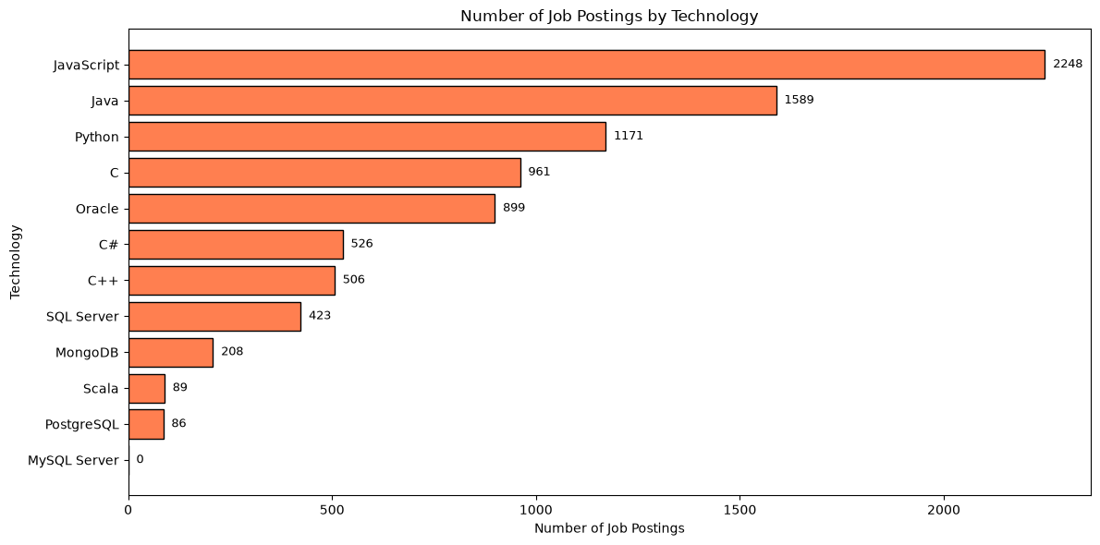
POPULAR LANGUAGES

Slide 9
PROGRAMMING LANGUAGE TRENDS
Current Year
Next Year

Slide 10
PROGRAMMING LANGUAGE TRENDS - FINDINGS & IMPLICATIONS
Findings:
- Finding 1: JavaScript/TypeScript Ecosystem Dominates Both Usage and Learning Intent
JavaScript ranks #1 in current usage (14,943) and #1 in learning desire (11,541)
TypeScript ranks #4 in usage (10,709) but #3 in learning intent (10,437) — highest growth signal
HTML/CSS and SQL round out top 3 in both charts — the "inescapable triad" for all developers
- Finding 2: Python Shows Saturation in Learning Demand Despite High Usage
Python is #5 in current usage (9,590) but drops to #5 in learning intent (8,919) — behind TypeScript and HTML/CSS
Indicates most developers who need Python already have it; new learners prioritize typed JavaScript and data fundamentals
Rust, Go, and Kotlin appear in top 15 "want" list but not top 10 "have" — emerging systems/cloud interest
- Finding 3: SQL Remains the Universal Constant Across All Developer Roles
SQL is #2 in both current usage (12,602) and learning desire (10,944)
Only technology with near-identical rankings in both charts — data querying is non-negotiable regardless of specialization
PostgreSQL leads database preferences (both have/want), with Redis showing rising learning interest
Implications
- Implication 1: Training Budgets Should Prioritize TypeScript and Cloud-Native Skills
Highest ROI: TypeScript training (bridges existing JS workforce to modern typed development)
Secondary: Rust/Go for systems/backend roles; cloud certifications (AWS/Azure/GCP) align with platform trends
De-prioritize: Basic Python onboarding — target advanced ML/framework specialization instead
- Implication 2: Hiring Profiles Must Require SQL + One Modern Language as Baseline
"Full-stack" now means: JavaScript/TypeScript + SQL + one backend language (Python/Java/Go)
Screen for PostgreSQL experience over MySQL — aligns with market direction
Expect candidates to know TypeScript; treat JavaScript-only as junior signal
- Implication 3: Technology Stack Decisions Should Bet on the JavaScript/TypeScript/SQL Triad
Long-term stability: Invest in Node.js/TypeScript backend, React/Next.js frontend, PostgreSQL data layer
Avoid fragmentation: Standardize on TypeScript across frontend/backend to reduce context switching
Monitor: Rust adoption for performance-critical services; WebAssembly for browser-edge compute

Slide 11
DATABASE TRENDS
Current Year
Next Year

Slide 12
DATABASE TRENDS - FINDINGS & IMPLICATIONS
Findings
Finding 1: PostgreSQL Commands Both Current Usage and Future Demand
PostgreSQL is #1 in current usage (11,514) and #1 in learning intent (12,193) — only database with higher want than have
Indicates active migration toward PostgreSQL; developers recognize it as the modern standard for relational data
MySQL (#2 have, #4 want) and SQL Server (#5 have, #6 want) show declining learning interest relative to PostgreSQL
Finding 2: Redis Emerges as the #2 Most Desired Database Despite Modest Current Usage
Redis ranks #6 in current usage (5,814) but jumps to #2 in learning intent (6,384) — largest positive gap
Signals strong demand for caching, session stores, real-time features, and vector search (AI/ML workloads)
Elasticsearch (#8 have, #7 want) and MongoDB (#4 have, #5 want) maintain steady interest for search/document use cases
Finding 3: Cloud-Native and Managed Databases Rising; Legacy Systems Declining
Supabase (#10 want, not in top 10 have) appears in learning list — managed Postgres gaining mindshare
DynamoDB (#9 have, #9 want) holds steady for AWS-native workloads
Oracle (#10 have, not in top 10 want) drops out of learning intent — legacy enterprise only
Implications
Implication 1: Standardize on PostgreSQL as Primary Relational Database
New projects: Default to PostgreSQL (widest talent pool, strongest ecosystem, cloud-managed everywhere)
Migration priority: Move MySQL/SQL Server workloads to PostgreSQL where feasible
Training: Invest in PostgreSQL administration, performance tuning, and advanced features (JSONB, partitioning, logical replication)
Implication 2: Add Redis to Core Infrastructure Stack
Redis is no longer optional — it's the #2 learning target for developers
Use cases: Caching layer, session store, rate limiting, pub/sub, vector similarity search (Redis Stack)
Ensure team has Redis ops expertise (persistence, clustering, memory management)
Implication 3: Evaluate Managed Services Over Self-Hosted for New Workloads
Supabase/Neon (managed Postgres), Upstash (managed Redis), MongoDB Atlas — reduce ops burden
Cloud provider offerings (RDS, ElastiCache, DocumentDB) align with DynamoDB/Aurora trends
Reserve self-hosted only for compliance, cost optimization at scale, or latency-critical edge cases

Slide 13

DASHBOARD
<Please present your dashboard in the following slides.>

Slide 14
DASHBOARD TAB 1: Current Technology Usage
Dashboard Insights:
- Languages: JavaScript (14.9K), SQL (12.6K), HTML/CSS (12.4K), TypeScript (10.7K), Python (9.6K) — JS/TS/SQL triad is universal.
- Databases: PostgreSQL (11.5K) dominates; MySQL (8.6K), SQLite (7.0K), MongoDB (5.9K), Redis (5.8K) follow.
- Platforms: AWS (10.9K) leads; Azure (6.7K), Google Cloud (5.5K) — big three = 85% share.
- Web Frameworks: Node.js (9.2K) ≈ React (9.0K) — full-stack JS default; Next.js (4.4K), Express (4.4K) rising.
Bottom line: 2024 stack = TypeScript + PostgreSQL + AWS + React/Node.js.

Slide 15
DASHBOARD TAB 2: Future Technology Trends
Dashboard Insights:
Languages to Learn: JavaScript (11.5K), SQL (10.9K), TypeScript (10.4K), HTML/CSS (10.0K), Python (8.9K) — JS/TS/SQL triad remains top priority.
Databases to Learn: PostgreSQL (12.2K) #1 by wide margin; Redis (6.4K) surges to #2; SQLite (6.3K), MySQL (6.2K), MongoDB (5.6K) follow.
Platforms to Learn: AWS (10.5K) leads; Azure (6.4K), Google Cloud (5.4K) — big three unchanged; Cloudflare (4.2K) rising.
Web Frameworks to Learn: React (8.2K) edges Node.js (8.1K); Next.js (4.5K) #3; ASP.NET Core (4.2K), Vue.js (3.9K) show framework diversification.
Bottom line: Learning intent mirrors current stack — TypeScript + PostgreSQL + AWS + React/Next.js is the career trajectory.

Slide 16
DASHBOARD TAB 3: Demographics
Dashboard Insights:
Age: Core workforce is 25–44 (66% of respondents); 25–34 largest cohort (7.8K). Under 18 and 65+ are minimal.
Geography: US dominates (3.4K, 23%); Germany, India, UK, Ukraine each 900–1.3K. Strong Eastern Europe presence.
Education: 66% hold Bachelor's+ (Bachelor's 8.6K, Master's 5.0K). Only 11% have secondary or less.
Role: 89% are professional developers (full-time 12.7K); freelancers 1.9K. Hobbyists/learners < 4%.
Compensation by Age: Steady climb — $12K (under 18) → $24K (18–24) → $60K (25–34) → $86K (35–44) → $101K peak (45–54) → $127K (55–64).
Satisfaction by Age: JobSatPoints_6 peaks at 20 for 18–64; dips for youngest (3) and oldest (10). JobSatPoints_7 similar pattern.
Bottom line: Developer population is mid-career, degree-holding, full-time professionals concentrated in US/Europe/India, with compensation peaking in late 40s and satisfaction high across prime working years.

Slide 17
DISCUSSION
Discuss overall insights derived from dashboards

Slide 18
OVERALL FINDINGS & IMPLICATIONS
Findings
Finding 1: Technology Stack Has Consolidated Around a Clear "Default" — TypeScript + PostgreSQL + AWS + React/Node.js
Current usage and learning intent align tightly: JavaScript/TypeScript/SQL triad dominates both charts
PostgreSQL leads databases in both have (11.5K) and want (12.2K); Redis surges to #2 in learning
AWS captures 40%+ of cloud mindshare; React/Node.js form the full-stack JavaScript backbone
Fragmentation is low — top 5 in each category capture 60-70% of mindshare
Finding 2: Career Trajectory Maps to Compensation and Satisfaction Peaks at 45–54
Median compensation climbs from $24K (early career) to $101K peak (45–54), then $127K (55–64)
Job satisfaction (JobSatPoints_6) holds at max (20) for ages 18–64; only dips for youngest/oldest
66% hold Bachelor's+, but 74% are full-time pros — experience outweighs formal education
Largest cohort (25–34, 7.8K respondents) earns $60K median — prime upskilling window
Finding 3: Emerging Skills Gap Centers on Typed JavaScript, Cloud-Native Data, and Systems Languages
TypeScript learning intent (10.4K) exceeds current usage gap — biggest upskilling opportunity
Redis (#2 want vs #6 have) and Supabase (emerging want) signal shift to managed, real-time, vector-ready data
Rust, Go, Kotlin appear in top 15 "want" but not top 10 "have" — systems/cloud/mobile growth vectors
Python learning demand saturated — advanced ML/framework specialization > basic onboarding
Implications
Implication 1: Organizations Should Standardize on the Consolidated Stack to Reduce Fragmentation
Adopt TypeScript across frontend/backend; PostgreSQL as default relational; AWS + one secondary cloud
Invest in React/Next.js + Node.js for full-stack velocity; deprecate legacy frameworks (jQuery, legacy Angular)
Budget for Redis and managed Postgres (Supabase/Neon/RDS) as core infrastructure, not add-ons
Implication 2: Talent Strategy Must Align with the 25–44 Career Window and Compensation Curve
Recruit: Target 25–34 developers ($60K median) for growth roles; 35–44 ($86K) for senior/lead
Retain: Satisfaction is high in prime years — focus on compensation bands at 45–54 peak ($100K+)
Upskill: Fund TypeScript, Redis, cloud certifications — highest ROI for mid-career developers
Hire for: SQL + TypeScript + one cloud as baseline; treat JavaScript-only as junior signal
Implication 3: Technology Investment Should Bet on the Convergence of Typed JavaScript, Managed Data, and AI-Ready Infrastructure
Platform: Standardize on AWS/Azure/GCP with Terraform/IaC; add Cloudflare for edge
Data: PostgreSQL + Redis + vector search (pgvector/Redis Stack) for AI/ML workloads
Language: TypeScript for application layer; Rust/Go for performance-critical services; Python only for ML specialization
Monitor: WebAssembly, serverless databases, and LLM-powered dev tooling as next disruption wave

Slide 19

CONCLUSION
Point 1: The Developer Ecosystem Has Converged on a Stable, Predictable Technology Core
JavaScript/TypeScript, SQL, PostgreSQL, AWS, and React/Node.js form the undisputed default stack
Low fragmentation means hiring, training, and tooling decisions carry lower risk than a decade ago
Point 2: The Highest-Value Upskilling Investments Are Clear and Actionable
TypeScript (bridging JS to typed development), Redis (caching → real-time → vector), and cloud-native managed services
Python basics are saturated; redirect budgets to advanced ML frameworks and systems languages (Rust/Go)
Point 3: Talent Pipeline Is Healthy But Requires Targeted Retention at Mid-Career
25–44 age group represents 66% of workforce with strong satisfaction and rising compensation
Peak earning years (45–54) need competitive $100K+ bands and growth paths to prevent attrition
Point 4: The Next Wave Is AI-Native Infrastructure — Prepare Now
Vector search (pgvector, Redis Stack), LLM-powered dev tooling, and serverless databases are entering learning intent
Organizations adopting the current consolidated stack will be positioned to layer AI capabilities without replatforming

Slide 20

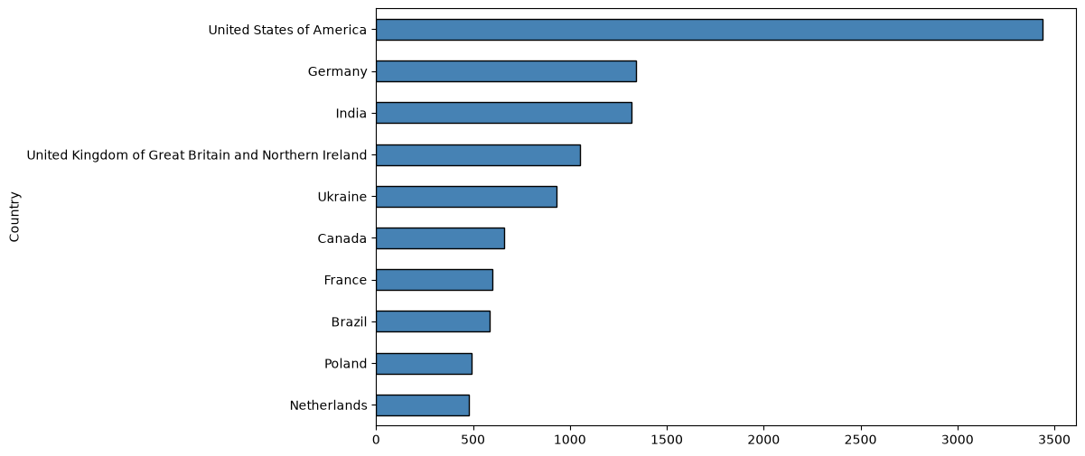
Appendix A: Top 10 Countries by Respondent Count

Slide 21
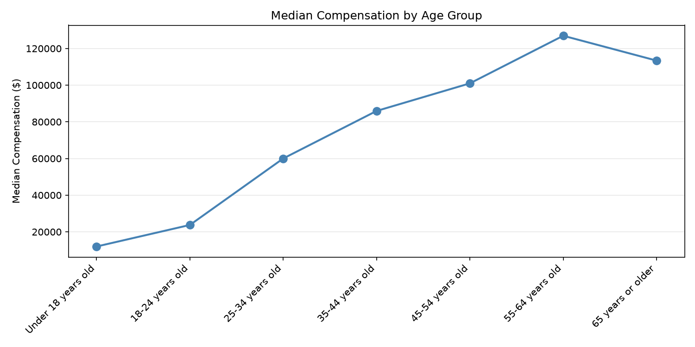
Appendix B: Median Compensation by Age Group

Slide 22
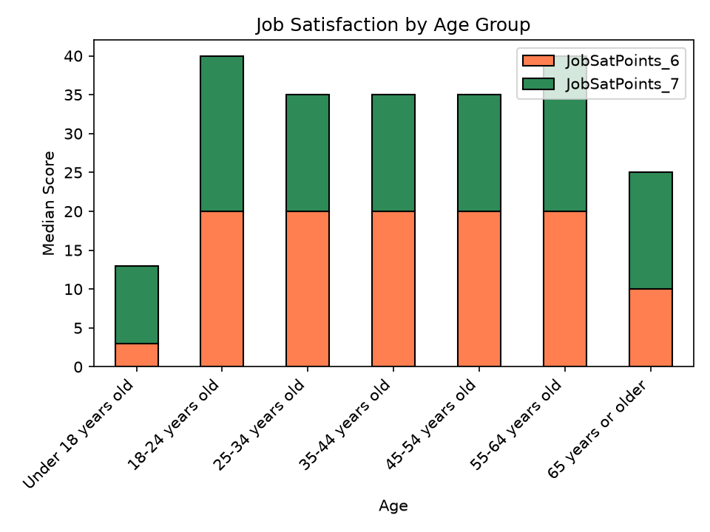
Appendix C: Median Job Satisfaction by Age Group

Slide 23
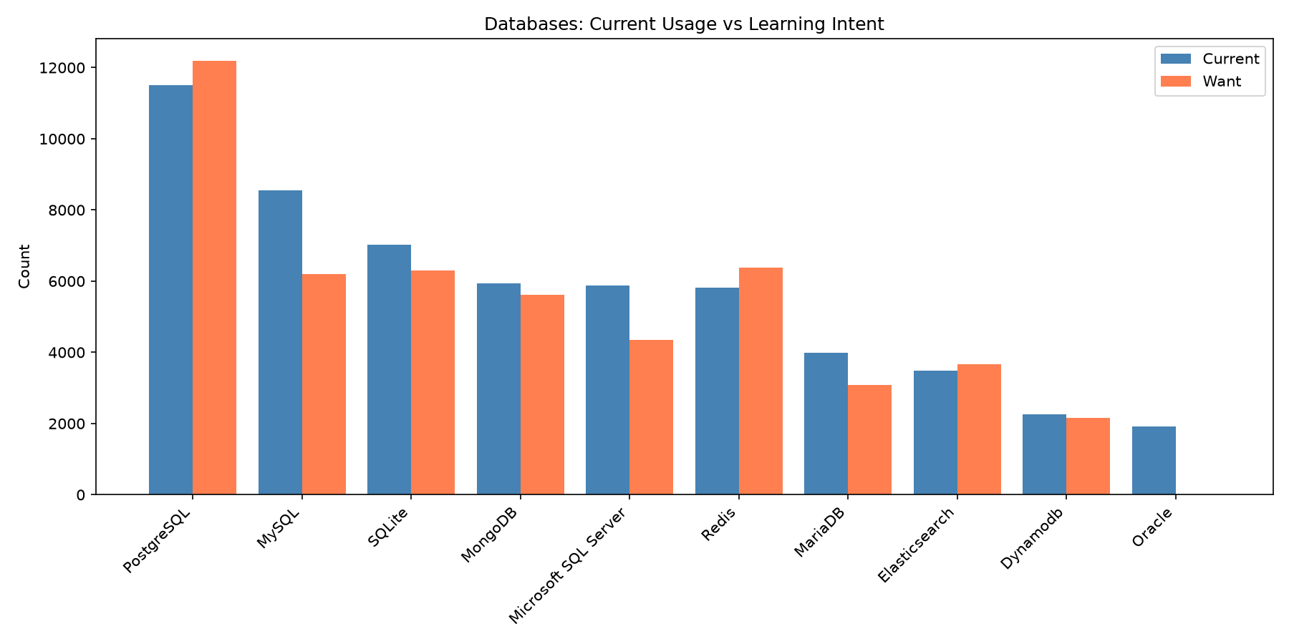
Appendix D: Databases — Current Usage vs. Learning Intent

Slide 24
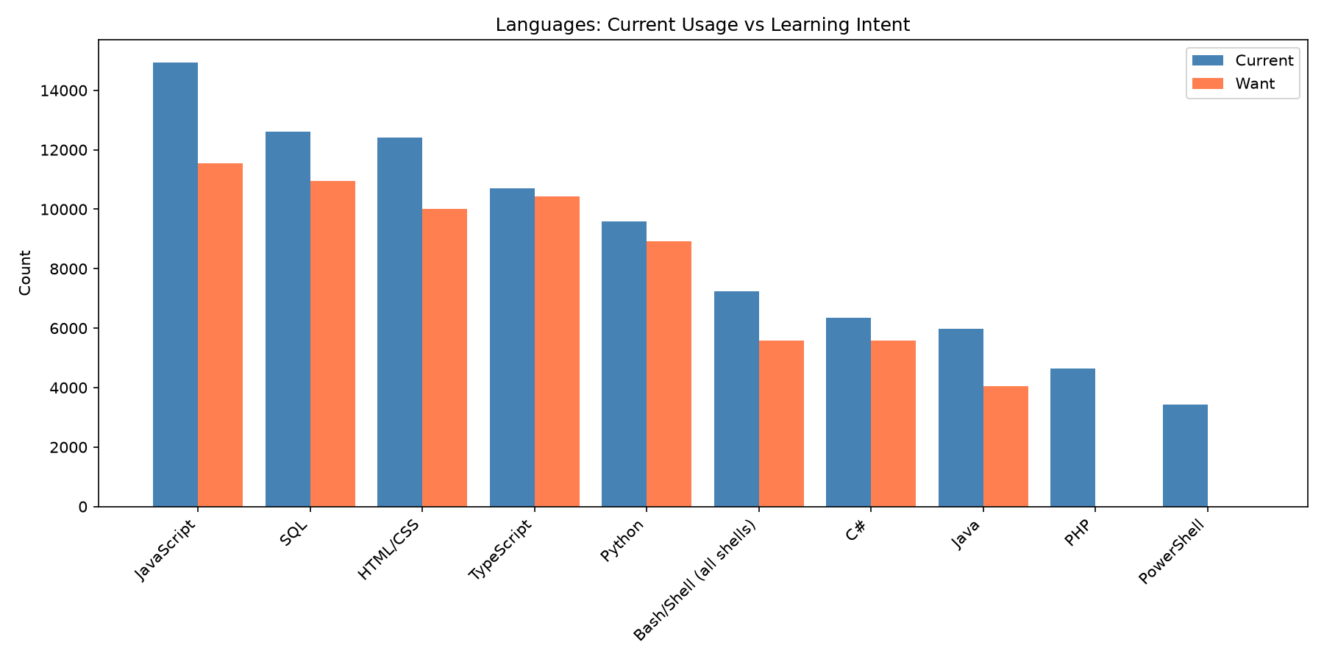
Appendix E: Programming Languages — Current Usage vs. Learning Intent

